Slide 1

The Dragon Key
Green Team

Slide 2
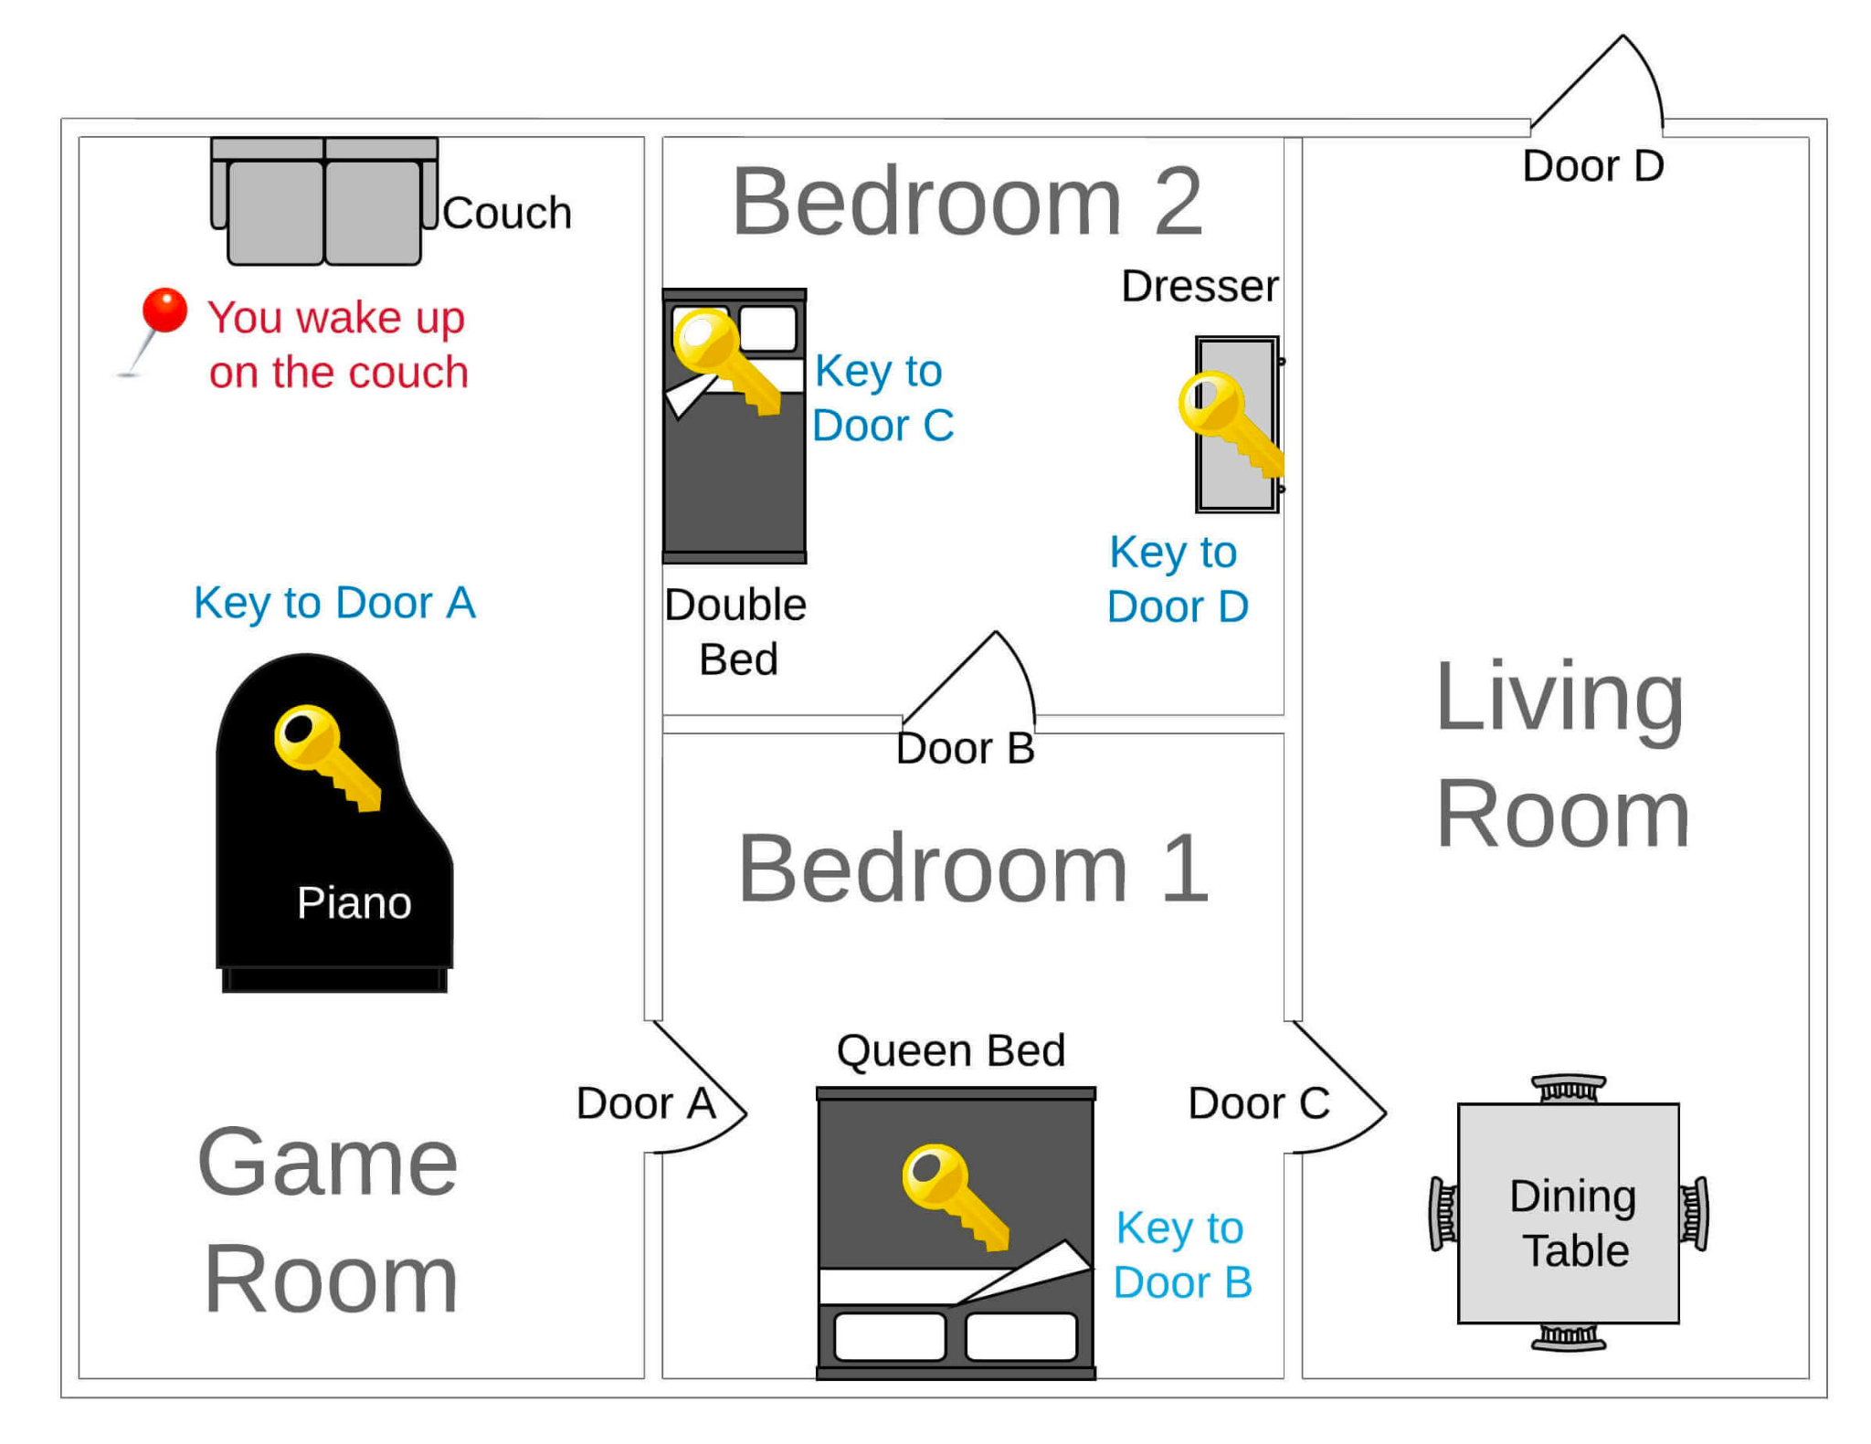
Game Narrative & Deliverable
Develop the game using Python based on the game design.
Expand the code following the example to create Bedroom 1.
Improve the MVP with New Features

Slide 3
Sales Speech with Demo
🔐 All-New Escape Room Experience! 🔐
Are you ready for the ultimate challenge?
🚪 New Rooms and Doors: Uncover secrets and hidden treasures in never-before-seen settings. With new rooms, new doors, and new enigmas, you'll be transported to a world of adventure and excitement!
🗝️ New Puzzles: Prepare to be amazed by our puzzles that challenge your logic, teamwork, and problem-solving skills. Can you crack the code, find the clues and escape?
Don't miss out on this thrilling opportunity to put your skills to the test. Book your adventure and prepare for an unforgettable experience!

Slide 4
Problem Solving Approach
Game Initialization:
Define all rooms, furniture, doors, and keys.
Define the relations between objects.
Initialize game state.
Pseudocode:
Print game's introductory message.
Determine the current room of the player.
If the current room is the target room (Outside), end the game with a success message.
Otherwise, ask the player for an action (explore or examine).
If action is "explore":
List all items in the current room.
Return to step 2.
If action is "examine":
Ask which item the player wants to examine.
If the item is in the current room:
If the item is a key, add it to player's keys_collected.
If the item is a door and player has the key, open the door and move to the connected room.
If the item is a door and player doesn't have the key, notify player that the door is locked.
Return to step 2.
Else, notify the player that the item isn't in the current room and return to step 2.

Slide 5
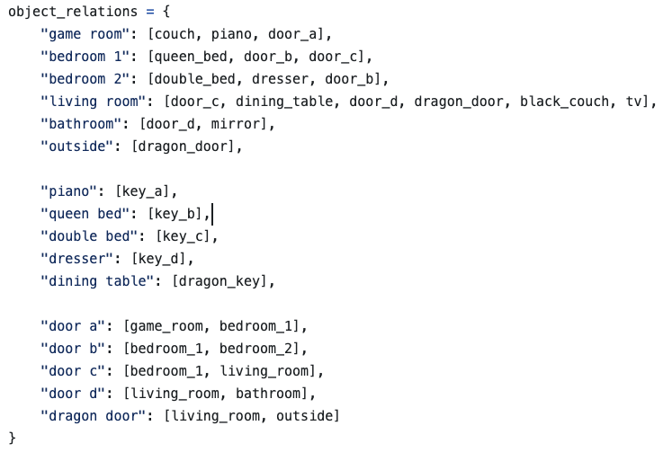
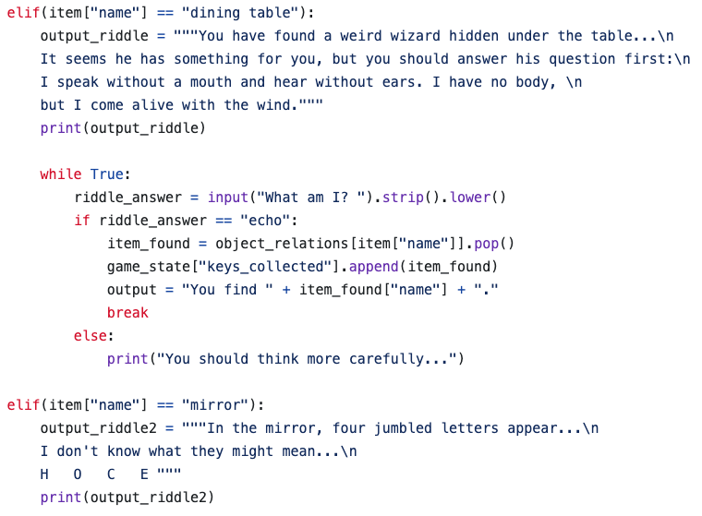
Technicalities

Slide 6
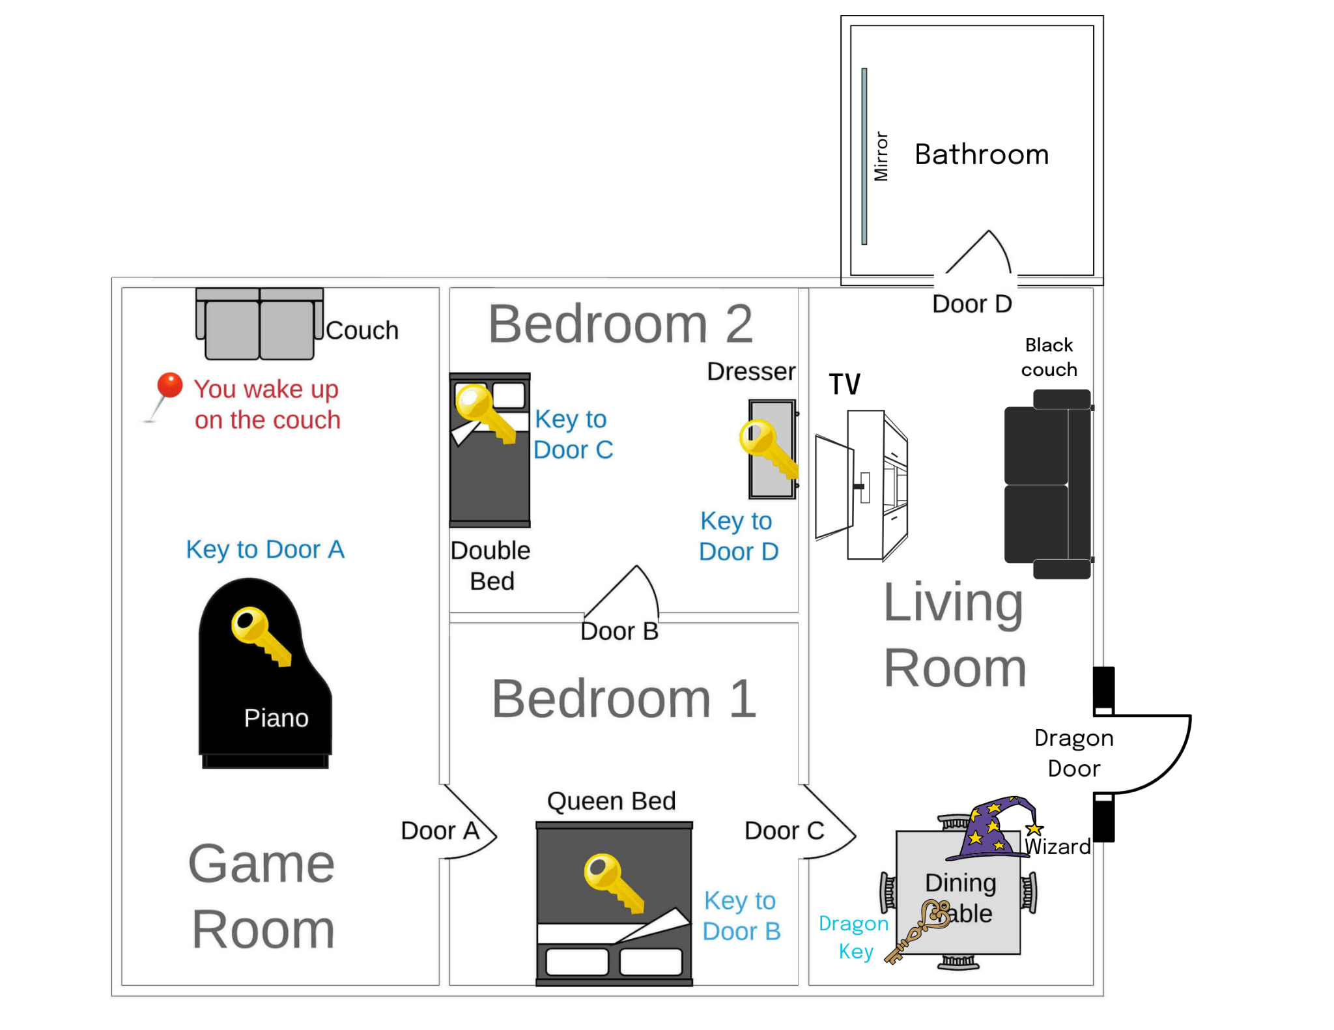
New Features
More Rooms:
Bathroom
More Doors:
Dragon door
More Keys:
Dragon key
More Furniture:
TV
Black Couch
Mirror
Interactions:
Quizzes (x2)
Characters
Wizard

Slide 7
Future Improvements
Different game modes:
Easy
Advanced
Legend
Multiplayer mode
Import and display images to add more interactive riddles
Doors locked by 2 or more padlocks

Slide 8
Project Management
Team Member | Role | Description
Whitney | Project Manager | Oversaw the project timeline, coordinated meetings, and ensured all deliverables were met on time.
Jonatan | Developer | Focused on writing, testing, and debugging the Python code for the project.
Pablo | Documentation & Repo Manager | Managed the GitHub repository, ensured that the project was properly documented, and submitted the repository link as required.
Osagie | Presentation Lead | Prepared the slides, rehearsed the presentation, and ensuring that it adhered to the given time constraints.

